Slide 1



Course Slides
QualityRights
Framtidas tjenester innen psykososial helse
WHO/Harold Ruiz
WAPR Konferanse- mai 2022
QualityRights

Slide 2
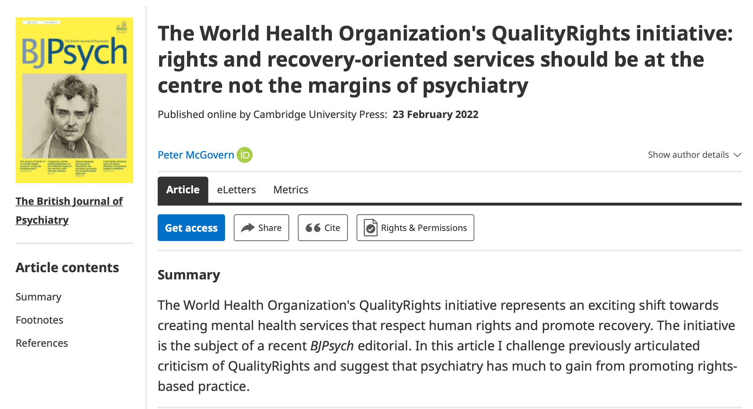
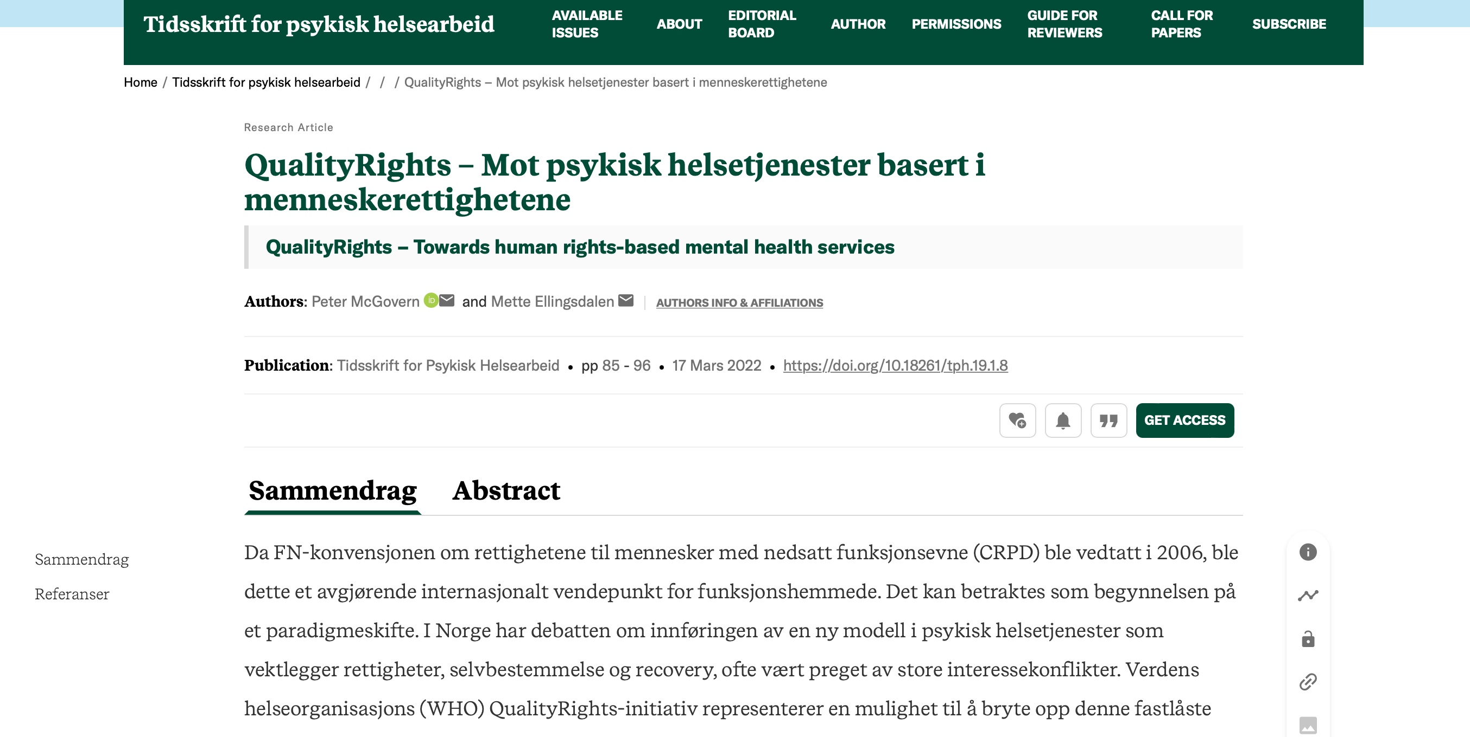

Slide 3
Vi vil si
Litt om struktur og innhold i WHO´s QualityRights initiativ
QualityRights som en løsning og veien videre - en mulighet til å bryte opp en fastlåst situasjon i Norge
Litt om beslutningsstøtte / fremtidsplanlegging
Psykiske helsetjenester ikke har noe å frykte, men faktisk mye å vinne på en menneskerettighetsbasert modell

Slide 4

“For decades, mental health services have been governed by a reductionist biomedical paradigm that has contributed to the exclusion, neglect, coercion and abuse of people with intellectual, cognitive and psychosocial disabilities, persons with autism and those who deviate from prevailing cultural, social and political norms”¹
Call for a paradigm shift
UN Special Rapporteur on the right to health
report in May, 2017
Notes:
Special attention should be paid to women, who suffer disproportionately from mental health practices that are based on paternalistic and patriarchal traditions, inappropriate and harmful gender stereotypes, medicalization of women’s feelings and behaviour, and coercion.
1. UN Human Rights Council. Report of the special rapporteur on the right of everyone to the enjoyment of the highest attainable standard of physical and mental health. A/HRC/35/21. United Nations.
http://ap.ohchr.org/documents/dpage_e.aspx?si=A/HRC/35/21

Slide 5
Reaksjoner?
Er dette noe som dere kjenner seg igjen i som en del av fagfeltet i Norge?
Er det en del av det han sier som du er enig i?
Hva slags følelser / tanker har du knyttet opp mot bruk av tvang i psykiske helsetjenester ?
Er det mulig å være psykiater / psykolog / fagperson / person med erfaring i Norge og være kritisk til systemet uten å bli stemplet som antipsykiatrisk / blir ekskommunisert?

Slide 6

Hva er Fn-konvensjonen om rettighetene til mennesker med nedsatt funksjonsevne - CRPD?
Fn-konvensjonen om rettighetene til mennesker med nedsatt funksjonseven – trådte I kraft i 2006
En respons på diskriminering og menneskerettighetsbrudd mot funksjonshemmede i hele verden.
Ikke nye eller flere rettigheter, men at alle menneskerettighetene gjelder for funksjonshemmede på lik linje med andre.
Bygger på en sosial og rettighetsbasert modell for funksjonshemming. (ikke en medisinsk modell)
Hva betyr CRPD for psykiske helsetjenester?
At vanlige og utbredte praksiser som tvangsbehandling, institusjonalisering og overformynderi ikke lenger er i tråd med internasjonal lov.
Skifte av modell må bety endring i maktforhold, fokus og kunnskapsutvikling.

Slide 7
CRPD – status sjekk?
Vedtatt i FN i 2006, ratifisert av Norge i 2013 med tolkningserklæringer.
Gjennomføringen av de endringer konvensjonen krever har gått sakte fremover i Norge, og har møtt av motstand og hindringer
I mars 2021 stemte regjeringen for tredje gang mot at CRPD skal inkorporeres i norsk lov. Det fremste argumentet mot inkorporering var at psykiske helsetjenester i Norge fortsatt skal kunne behandle mennesker mot deres vilje, og at man skal kunne bruke umyndiggjøring/ vergemål. (brudd på rettighetene i henhold til CRPD).
Hurdalerklæringen lover inkorporering
CRPD-komiteen til Norge våren 2019
skiftet fra en medisinsk modell til en sosial/ menneskerettslig modell som ligger i CRPD ikke hadde fått feste i Norge
Klare anbefalinger som gjelder endring i lovverk og tvang
kunnskapsbygging og opplæring i den sosiale/menneskerettslige modellen for funksjonshemming

Slide 8
Hva kan QualityRights tilby?
En mulighet til å innlemme den forståelsen av psykiske helseproblemer som ligger i CRPD i psykiske helsetjenester
Praktisk veiledning om hvordan tjenester kan utvikle seg i en retning som er:
Fundert i rettigheter og fritt og informert samtykke
Rettslig handleevne på lik linje med andre
Deltagelse og inkludering
Recovery
Notes:
WHO is working to improve the quality of care provided by mental health services and promote the human rights of people with psychosocial, intellectual, and cognitive disabilities.
3. WHO. ((accessed June 8, 2017).)WHO QualityRights initiative – improving quality, promoting human rights. World Health Organization, ; 2017
http://www.who.int/mental_health/policy/quality_rights/en/

Slide 9
Hva kan QualityRights tilby?
Opplæring i CRPD og Recovery
Veiledning i utvikling av lov og politikk
Utvikle person og- recovery orienterte tjenester basert i menneskerettighetene
“The active involvement of the psychiatric profession and its leaders in the shift towards rights-compliant mental health policies and services is a crucial element for success in positive global mental health changes”¹ SR Helse 2019
Notes:
WHO is working to improve the quality of care provided by mental health services and promote the human rights of people with psychosocial, intellectual, and cognitive disabilities.
3. WHO. ((accessed June 8, 2017).)WHO QualityRights initiative – improving quality, promoting human rights. World Health Organization, ; 2017
http://www.who.int/mental_health/policy/quality_rights/en/

Slide 10
Har du noe tanker om hvordan vi kan få dette til?
Hvorfor er det så mye motstand mot denne tilnærmingen?

Slide 11
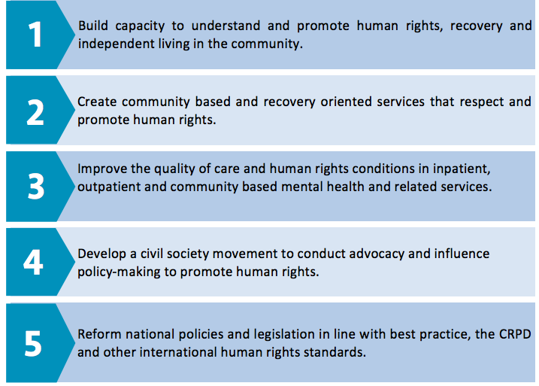
Objectives of Quality Rights
Notes:
4. WHO QualityRights tool kit to assess and improve quality and human rights in mental health and social care facilities. Geneva, World Health Organization, 2012.

Slide 12


Slide 13
Course Slides
Human Rights
WHO/Heba Farid
WHO QualityRights core training - for all services & all people
QualityRights

Slide 14
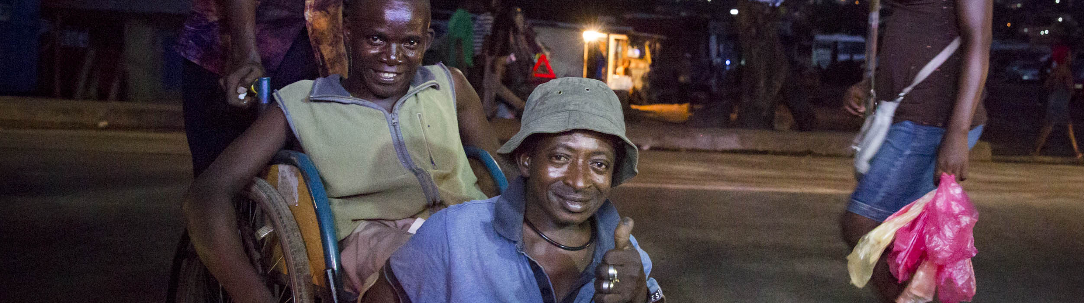
Course Slides
Mental health, disability and human rights
CBM/Sarah Isaacs
WHO QualityRights core training - for all services & all people
QualityRights

Slide 15
Course Slides
Legal capacity and the right to decide
WHO/Harold Ruiz
WHO QualityRights core training: mental health & social services
QualityRights

Slide 16

Course Slides
Freedom from coercion, violence and abuse
CBM/Cathy Greenblat
WHO QualityRights core training: mental health & social services
QualityRights

Slide 17
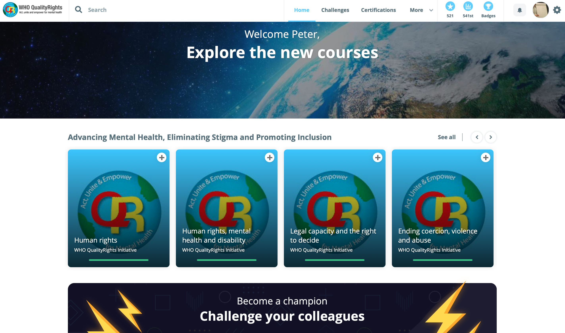
E-training version of 6 core human rights modules
Reach, engage and train more people
Identify champions and build stronger movement to advocate for human rights & quality services
Change in cultural norms and practices

Slide 18


Capacity building on human rights
in mental health
QualityRights e-training
Mental Health, recovery and community inclusion
Changing mindsets of whole communities, on massive scale
Free of cost and open to all
Available in 11 languages including English, Spanish and French
WHO certificate upon completion
Target:
5 million learners to complete the e-training by end 2024
Notes:
On April 12 this year, Dr Tedros, Director General of the World Health Organization launched the new WHO QualityRights e-training on mental health, recovery and community inclusion, together with Dr Michelle Bachelet, the UN High Commissioner for Human Rights, several Ministers of Health and other high-level representatives.
Through the e-training WHO aims to build capacity and change mindsets and practices on a massive scale in order to end stigma and discrimination and promote rights, recovery and inclusion in the area of mental health.
The e-training is available free of cost and open to all people.
It is currently available in 11 languages including English, Spanish and French
Once all six modules of the course are completed, an official WHO certificate of completion is awarded to learners.
Dr Tedros Adhanom Ghebreyesus, Director-General of WHO has set an ambitious target for this global e-training and rollout campaign: five million learners to complete the e-training by the end of 2024.

Slide 19
Rights based law reform
Impact of WHO’s QualityRights e-training
  60,0000 enrollments, 30,000 successful completion
  E-training implementation in Ghana, Bosnia & Herzegovina, Czechia, Kenya, Philippines, Turkey and Zimbabwe
  Translation into 11 languages:
  English, French, Spanish, Armenian, Bosnian, Czech, Estonian, Filipino, Italian, Polish, Turkish
First phase e-training evaluation:
  Highly significant changes on all pre and post training attitudinal scores (p<0.0001)
  38% improvement in overall attitudes towards a rights-based approach aligned with the CRPD
Notes:
19
Just to provide a quick overview of where we are at with the QR e-training so far:
During the first phase of the QR e-training implementation leading up to the global launch, the training has been implemented with great success in 7 countries, including Ghana, Kenya and Zimbabwe.
In total, 60,000 people have enrolled of which 30,000 people have already successfully completed the course with the majority of learners coming from Ghana.
The training is available in the 11 languages listed on this slide with more translations including Arabic being available until the end of 2022
I would also like to share some of the impactful results of the first phase pre and post training evaluation:
Out of the 17 attitudinal items that we are measuring we are seeing highly significant changes on all 17 items.
The latest analysis of data is showing a 38% improvement in overall attitudes towards a rights-based approach aligned with the CRPD.

Slide 20
Access QualityRights e-training at:
https://www.who.int/teams/mental-health-and-substance-use/policy-law-rights/qr-e-training
Notes:
You can find the link to access the QR etraining on this slide
We encourage you to take the course and to share the e-training widely among your colleagues, networks, family and friends!

Slide 21
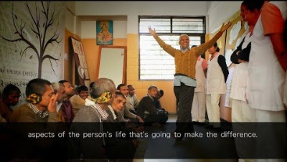

Slide 22
GRAND DESIGNS: Person-sentrerte / recovery orienterte tjenester:
Hvordan ser de ut?
Forteller meg litt om bygningen / hvor er det?
Kan du beskriver kulturen? Regler? (ink det usagte)
Hvordan snakker folk med hverandre?
Hva er forskjellen mellom en Recovery orientert tjeneste og det som vi har i Norge per i dag?

Slide 23


Slide 24

Veileder i samfunnsbaserte psykiske helsetjenester
Tjenester i basert i menneskerettighetene
Fem kjerne-prinsipper tjenestene må oppfylle:
Respekt for rettslig handleevne
Ikke tvangsbasert praksis
Deltagelse og medvirkning
Inkludering i samfunnet
Recovery og personsentrert praksis

Slide 25
Har vi som mennesker alltid den evnen for å bestemme selv?
Trenger vi støtte inni mellom?
Hva med retten for å bestemme selv?

Slide 26
Supported decision-making / Beslutningsstøtte
Står i motsetning til overformynderi eller beslutningstaking fra tredjeparter
Skiftet fra beslutningstaking ovenfra basert på hva som anses som «personens beste», til støtte til beslutninger fundert i personens vilje, ønske og verdier
CRPD anerkjenner at alle mennesker, uavhengig av forutsetninger eller kompetanse, har en vilje og preferanser og rett til at dette respekteres og understøttes.
Beslutningsstøtte handler om å forstå, støtte og gjennomføre personens egen vilje og valg, ikke å få dem til å ta valg som er i tråd med det behandlingspersonale/pårørende/omgivelsene mener er det beste.
Det vil variere hvor mye støtte man ønsker og trenger, avhengig av hvilke personlige behov man har.
Notes:
Presentation: Supported decision-making (9) (50 min.)
At times, we may all need support to make decisions in different areas of life. Also there may be times in life when we all may find it difficult and challenging to make decisions by ourselves.
At times like these it can be useful to turn to people we trust who can support us in the process of making our decision. In fact, we all use support at times when making decisions and choices, especially when we need other people’s perspectives and skills to supplement our own.
In acknowledgement of this, article 12 of the CRPD recognizes and promotes the concept of “supported decision-making”.
This article states that people must have access to a variety of support options. including the support of people they trust (e.g. family, friends, peers, advocates, lawyers, personal ombudsperson, etc.).
It recognizes that building on people’s unique abilities and providing them with the support they require allows them to make their own decisions.

Slide 27
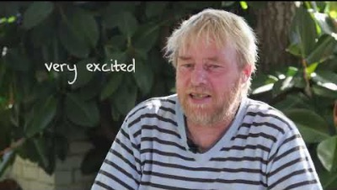

Slide 28
Fremtidsplanlegging
Hva er en framtidsplan?
Mulighet til å dokumentere egen vilje og preferanser på forhånd
Skape en dokument som kan fungerer som en veileder for helsepersonell i en krise
Respekterer en persons rettslig handleevne
Ulysees klauser:
Dette kan være aktuelt hvis en person vet at han i en ekstrem tilstand vil kunne gjøre ting han vil angre på og ikke ønsker, og vil hindres fra dette.
Denne type avtaler, som innebærer å handle mot personens vilje i øyeblikket ut fra tidligere uttalte ønsker, må følges opp grundig for å sikre at det som gjøres faktisk er i tråd med personens ønsker.
Innebærer å gjøre avtaler som kan innebære midlertidig bruk av eks. tilbakeholdelse etter personens tidligere uttalte vilje.
Notes:
Advance planning can have two functions:
If a person has difficulty in expressing his or her wishes, the people providing support and care to that person can refer to the advance plan as a communication tool and reference to find out the person’s wishes and preference. Supporters can remind the person of what they discussed and what they outlined in the advance plan.
In addition, in some countries, advance plans can also be used as a legal document in which the person authorizes – or refuses – certain actions to be undertaken in a particular situation in the future.
At the same time, it is important to be aware that advance plans are not a static, non-changing document.
People’s views, will and preferences may evolve and people can and do change their minds about things.
Supporters should therefore engage and consult with the person on a regular basis to determine if their will and preferences have changed and if they agree with the actions being proposed.
Advance plans are sometimes also known as living wills or advance directives.

Slide 29

Finnes det en konsensus i det psykiatriske fagfeltet?
Har vi tid til å vente på at psykiatri skal endre seg?

Slide 30
Konklusjon:
Nå er det tid for aksjon – Fra kritikk og debatt til handling
Politisk ledelse og mot trengs for å skape person-sentrerte og recovery orienterte tjenester i Norge
En start med BET og medisin-frie tilbud men vi trenger å utvide det som funker og skape flere innovative / nye tjenester / (krise-team, sanctuary modell, recovery teams, tilgang til 24/7 støtte uten tvang). Heidenheim / Åpen dialog
Respekt for rettslig handleevne
En slutt på tvangsbasert praksis
Fokus på deltagelse og medvirkning
Inkludering i samfunnet
En mer holistisk tilnærming til psykisk helse som involverer hele det norske samfunnet, ikke bare psykiatri eller diagnosebaserte psykisk helse tilbud.

Slide 31
References
UN Human Rights Council. Report of the special rapporteur on the right of everyone to the enjoyment of the highest attainable standard of physical and mental health. A/HRC/35/21. United Nations.http://ap.ohchr.org/documents/dpage_e.aspx?si=A/HRC/35/21
Funk, M; Drew N. WHO QualityRights: transforming mental health services. The Lancet Psychiatry. July 2017
WHO. ((accessed June 8, 2017).)WHO QualityRights initiative – improving quality, promoting human rights. World Health Organization, ; 2017http://www.who.int/mental_health/policy/quality_rights/en/
WHO QualityRights tool kit to assess and improve quality and human rights in mental health and social care facilities. Geneva, World Health Organization, 2012.
The United Nations. Convention on the Rights of Persons with Disabilities, arts. 12 and14, Committee on the Rights of Persons with Disabilities, general comment No. 1 and guidelines on article 14 of the Convention. 2008
Promoting human rights in mental health - WHO QualityRights training to act, unite and empower for mental health (pilot version). Geneva: World Health Organization; 2017 (WHO/MSD/MHP/17.2). Licence: CC BY-NC-SA 3.0 IGO
Pathare, S, Kalha, J, Joseph, T, Funk, M, Drew-Bold, N, and Khenti, A. QualityRights Gujarat. in: P Kerrigan, S Bhattacharya, S Peel, M Romero Sá, R Kishore, A Wade (Eds.) Mental health: pasts, current trends and futures. Centre for Global Health Histories, University of York. Orient Blackswan, York, UK; 2017: 64–78
Pathare, Funk, Drew et al. A Systematic Impact Evaluation of Implementation of QualityRights Program in Public Mental Health Facilities in Gujarat, India (Pending publication)
Shah et al. Impact of Quality Rights Gujarat program on dropout rates of patients visiting outpatient psychiatry department of tertiary care hospital. Asian Journal of Psychiatry 28 (2017) 4-8
Australian Department of Health. The firth National Mental Health and Suicide Prevention Plan 2017-2022

Slide 32

So hope for a great sea-change
On the far side of revenge.
Believe that a farther shore
Is reachable from here
From: The Cure at Troy
By Seamus Heaney

Slide 33
Questions / comments?
mette.elling@gmail.com
petemcgovern@me.com

Slide 34
Access QualityRights e-training at:
https://www.who.int/teams/mental-health-and-substance-use/policy-law-rights/qr-e-training
Notes:
You can find the link to access the QR etraining on this slide
We encourage you to take the course and to share the e-training widely among your colleagues, networks, family and friends!

